Slide 1

WORLDWIDE CAMPUS | COLLEGE OF ARTS & SCIENCES
Introduction to
Hypothesis Testing
DSCI 413
Statistics for Data Science
Dr. Darryl Chamberlain Jr.
Assistant Professor of Educational Data Science
Department of Mathematics, Science, and Technology
College of Arts & Sciences, Worldwide

Slide 2
Introduction
Goal of a Hypothesis Test
Make a claim about unknown population value(s)
1-Pop Example from textbook:
You get hired as a server at a local restaurant, and the manager tells you that servers’ tips are $42 on average but vary about $12. You decide to track your tips to see if you make a different amount, but because this is your first job as a server, you don’t know if you will make more or less in tips. After working 16 shifts, you find that your average nightly amount is $44.50 from tips.
2-Pop Example from textbook:
A professor wants to see how much students learn over the course of a semester. A pre-test is given before the class begins to see what students know ahead of time, and the same test is given at the end of the semester to see what students know at the end.
Notes:
Full text slide

Slide 3
Introduction
How it Works
Build a probability model for the population data
Make some guess about the population value (called the null hypothesis)
Using the sample data, place where that sample fits on the probability model (called the Test Statistic)
Find the probability of the sample data happening (called the p-value)
Either reject the guess about the population value because the sample data is so unlikely to happen under that assumption or fail to reject the guess about the population value because the sample data could have come from that population.
Notes:
Full text slide

Slide 4
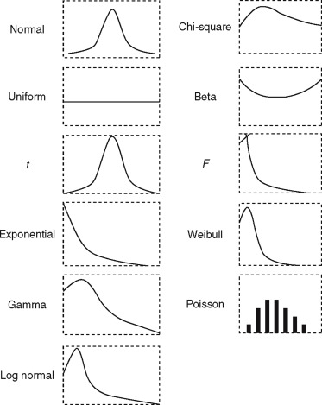
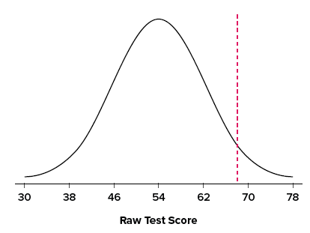
Probability Distribution
What is a Probability Distribution?
Common Distributions
A probability distribution shows how likely a random variable is to take a specific value.
The area under the curve is the probability of some value X on the curve.
Notes:
Full text slide

Slide 5
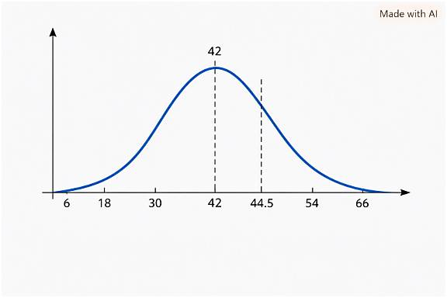
Probability Distribution Example
Hypothesis Test Example
1-Pop Example from textbook:
You get hired as a server at a local restaurant, and the manager tells you that servers’ tips are $42 on average but vary about $12. You decide to track your tips to see if you make a different amount, but because this is your first job as a server, you don’t know if you will make more or less in tips. After working 16 shifts, you find that your average nightly amount is $44.50 from tips.
Instructor note: I tried to get Copilot multiple times to make the dashed line at 44.5 closer to 42 but gave up.
Notes:
Full text slide

Slide 6
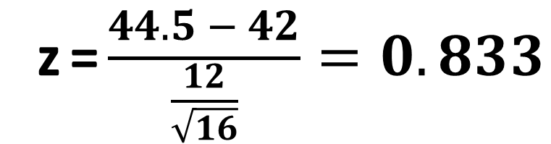

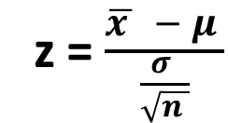
Probability Distribution Example
Test Statistic
Test Statistic:
z=$\frac{difference from hyp }{standard error}$
z=$\frac{\overline{x} −μ}{\frac{σ}{\sqrt{n}}}$
z=$\frac{44.5 − 42}{\frac{12}{\sqrt{16}}}=0.833$
Instructor note: I tried to get Copilot multiple times to make the dashed line at 44.5 closer to 42 but gave up.
Notes:
Full text slide

Slide 7
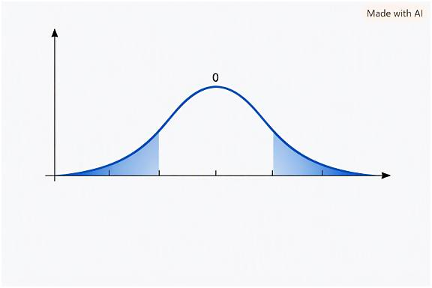
Probability Distribution Example
P-value
P-value: Area under the curve of test statistic, based on the alternative hypothesis
In this case, our alternative of “average tips of $42” is “average tips not equal to $42”. So we want the probability of getting our test statistic or greater as well as less than the negative version.
$$−0.84$$
$$0.84$$
Instructor note: Copilot completely failed trying to get the shading and other dashed values in the right spot, so I removed the numbers and manually placed them on the slide.
p =2*NORM.S.DIST(-0.84, 1) = 0.41
Notes:
Full text slide

Slide 8
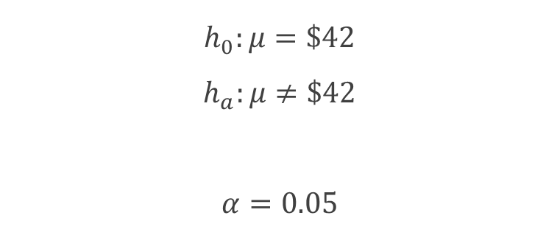
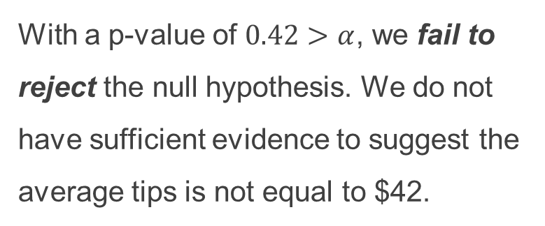
Probability Distribution Example
Conclusion
$$h_{0}:μ=\$42$$
$$h_{a}:μ≠\$42$$
$$α=0.05$$
$$−0.84$$
$$0.84$$
With a p-value of $0.42>α$, we fail to reject the null hypothesis. We do not have sufficient evidence to suggest the average tips is not equal to $42.
Notes:
Full text slide

Slide 9

Email if you still have questions!
Notes:
Questions slide

